Slide 1
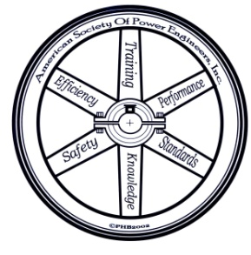
Boiler Room LOG Sheets: Interpreting the Records
Presented By: Byron Nichols
Representing: The American Society of Power Engineers

Slide 2
The Basic Log Book should record such readings as:
System Pressures
System Temperatures
Fuel Meter Readings
Fuel Inventory
Water Test Results
Chemical additions

Slide 3
How should these readings be recorded?
As often as necessary to insure the safe and efficient operation of the system. This can be a little a once per day, twice per day, or once every hour.
With few exceptions the more reading taken give better data and can indicated system upset which can be missed using less frequent inspection methods.
Reading should be taken at the same time of day.

Slide 4
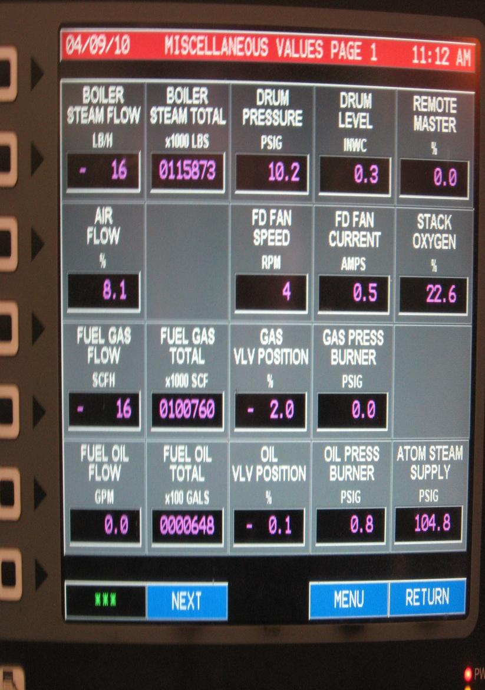
How do we record system variables:
Reading are recorded in written form.
Readings are logged using computer programs.

Slide 5
The First Step: Do the numbers make sense?
A basic understanding of the relationships of the operating principles of boilers and unit conversions will help to identify false or grossly inaccurate data.
Let’s look at a few examples:

Slide 8
42,000 lb/hr X 24 hr/day = 1,008,000 lb/day
1,008,000 lb/day ~ 960,000 lb/day
√

Slide 10
1 lb steam ~ 1,000 BTU
960,000 lb/day x 1,000 BTU/lb = 960,000,000 BTU day
1 gallon #2 fuel oil ~ 138,000 BTU
9,200 gal/day x 138,000 BTU/gal = 1,269,600,000 BTU/day
960 MMBTU ≠ 1,269.6 MMBTU
Efficiency = heat out / heat in
960 MMBTU / 1,269.6 MMBTU ~ .76 or 76%
√

Slide 11
The Basic Log Book should record such readings as:
System Pressures
System Temperatures
Fuel Meter Readings
Fuel Inventory
Water Test Results
Chemical additions

Slide 13
System Pressures (1/3):
Relatively constant boiler pressure = smooth system operations.
Stress resulting from pressure is held within acceptable limits.
Constant pressure = constant temperature (unless boiler is equipped with superheaters).
Constant temperature minimizes thermal stresses.
Wide variations in pressure indicate system problems.

Slide 14
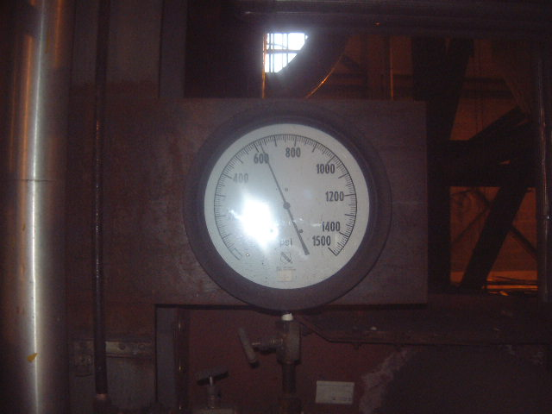
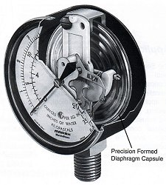
System Pressures (2/3):
Pressure gauges must be correct type for the application. Have the proper range, be properly installed and calibrated.
Pressure gauges come in many types depending on the application:

Slide 15
System Pressure 3/3):

Slide 16
Looking at pressure trends:
Boiler Pressure (excessive droop or improper tuning).
Feedwater pressure (worn pump).
Deaerator pressure (improper pressure control tuning, malfunctioning steam pressure regulator, improperly sized unit, too much make-up water).
Fuel oil pump (malfunctioning regulator, worn pump, clogged strainer).
Burner oil pressure (plugged burner tip, malfunctioning regulator).
Furnace pressure (soot slag build-up, improper damper operation).

Slide 18
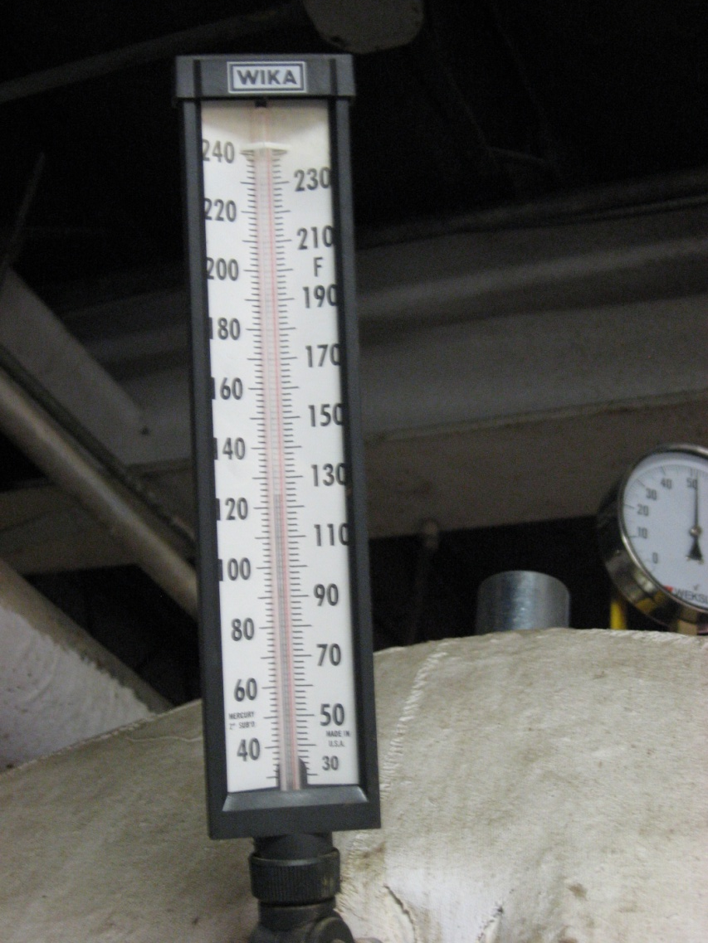
The Basic Log Book should record such readings as:
System Pressures
System Temperatures
Fuel Meter Readings
Fuel Inventory
Water Test Results
Chemical additions

Slide 19
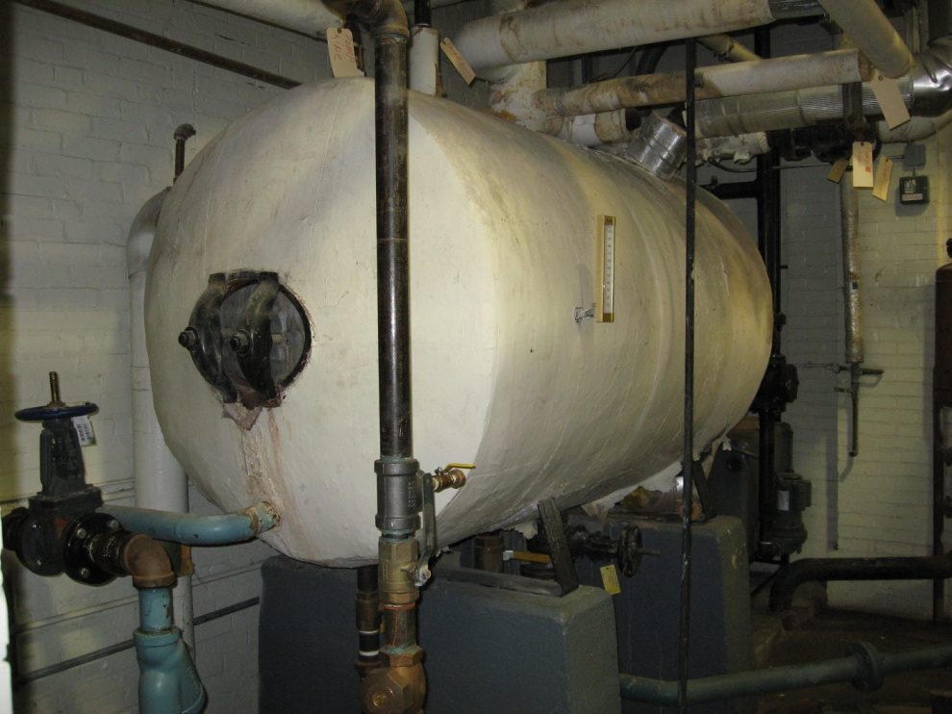
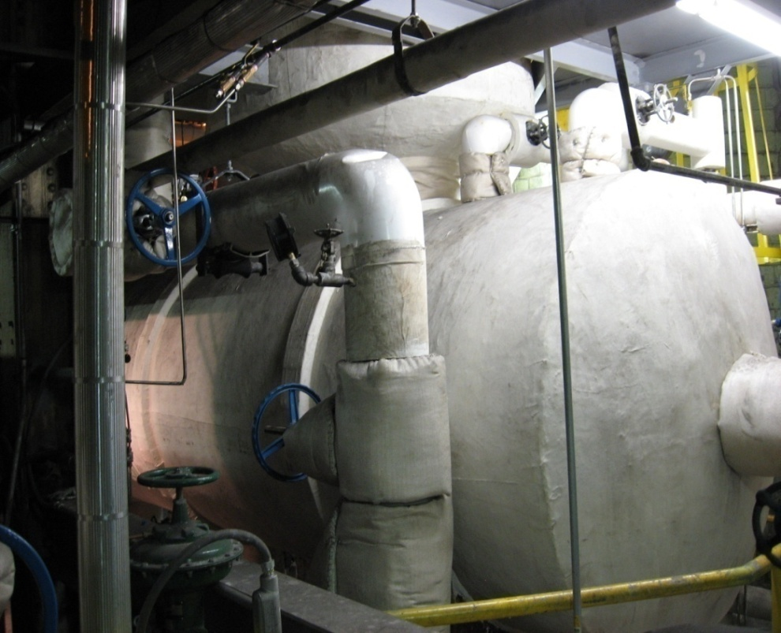
System Temperature may include:
Feedwater tank or Deaereator temperatures.
Stack gas outlet temperature.
Fuel oil temperature (if burning heaver grades of fuel oil).

Slide 20
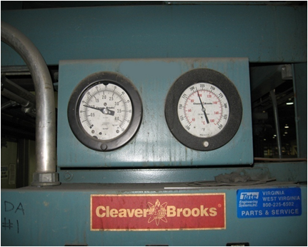
What should the water temperature be leaving the deaerator:
Within 3 to 5°F of the steam temperature supplied to the deaerator.

Slide 22
How to we determine the pressure temperature relationship?
We can refer to the steam tables.

Slide 24
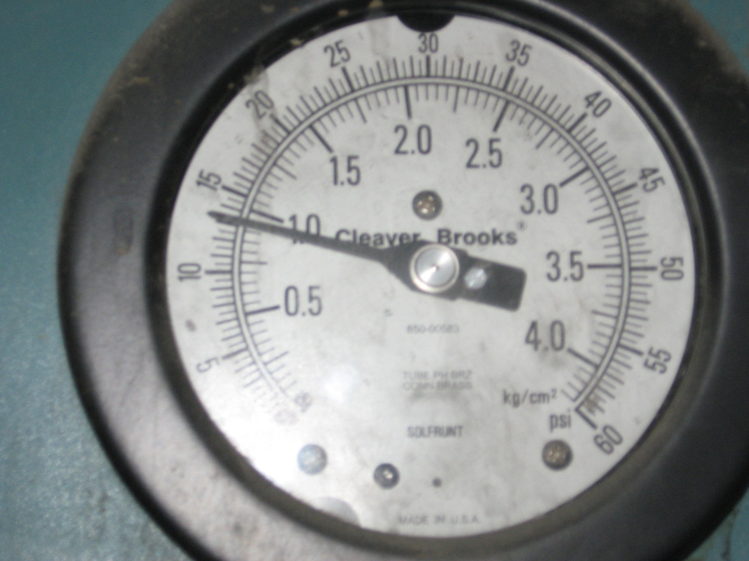
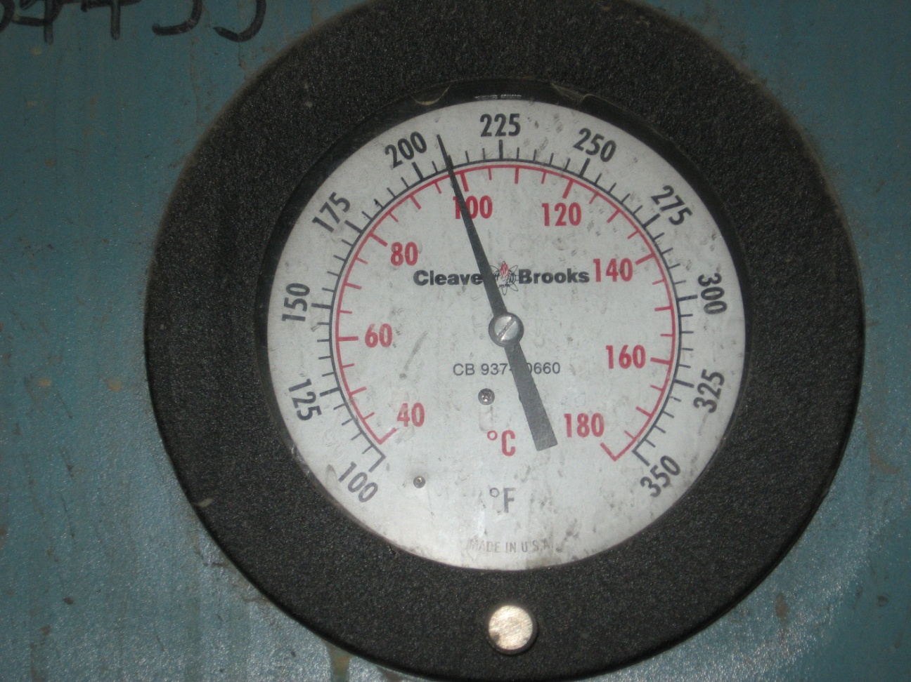

Slide 26
How is the pressure in the deaerator controlled?
A pressure control valve or regulator is used to maintain a constant pressure in the deaerator.
remember:
constant pressure = constant temperature

Slide 27
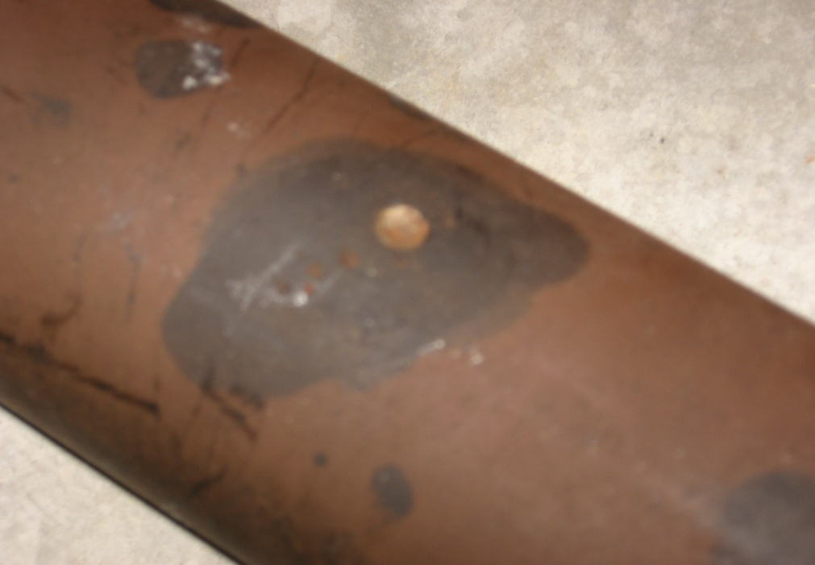
Deaerators:
Feedwater inlet
Steam inlet
Storage Tank

Slide 28
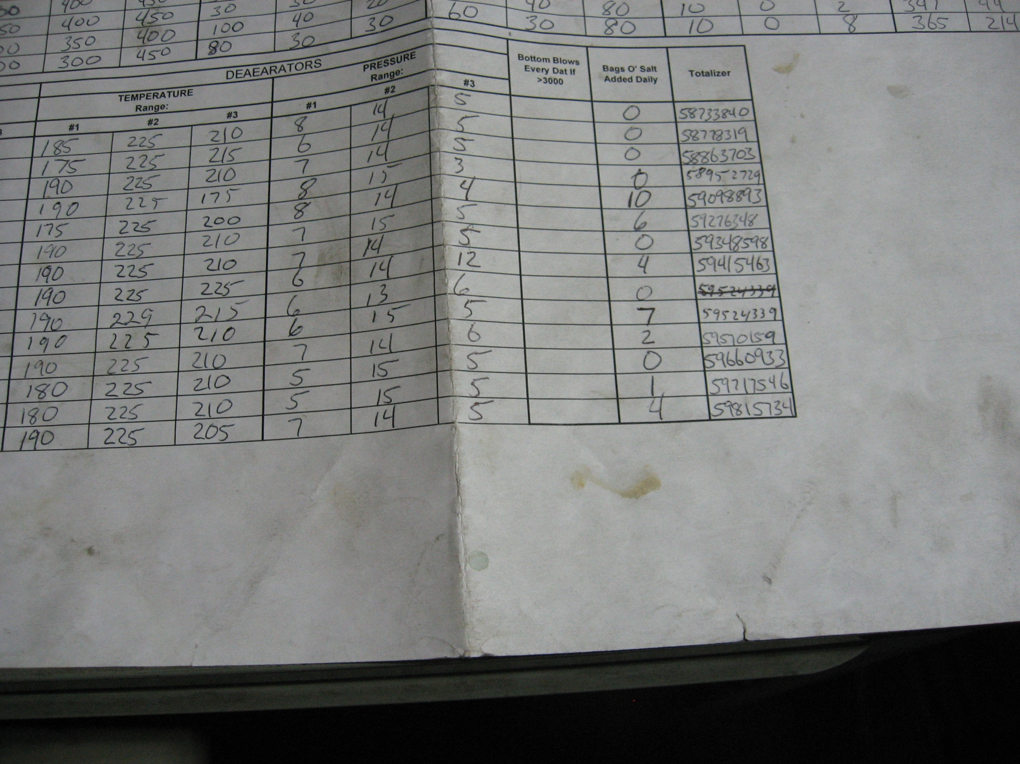

Slide 29
Stack Temperature:
The single biggest loss in boiler operation is heat up the stack. It can be affected by several factors:
Burner tuning.
Excess air.
Scale deposits.
Soot deposits.
Damaged refractory.
Broken fire side baffles.

Slide 31
Baffles direct the flow of flue gases to allow heat to be transferred from the gases of combustion to the water in the boiler:
To Stack
Combustion Chamber
Baffle

Slide 32
Stack Temperature:
The single biggest loss in boiler operation is heat up the stack. It can be affected by several factors:
Burner tuning.
Excess air.
Scale deposits.
Soot deposits.
Damaged refractory.
Broken fire side baffles.

Slide 33
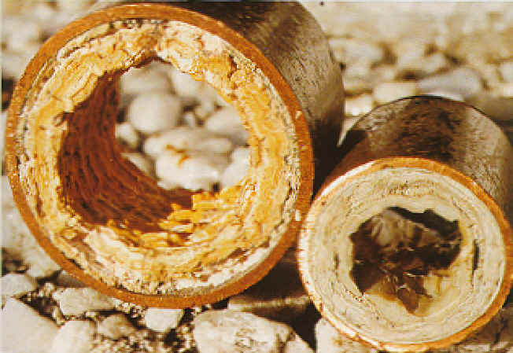
What is scale?
Scale is the collection of mineral deposits formed on the heating surfaces of a boiler.

Slide 34
The effect of scale:
Thickness Efficiency Loss
1/64” 4%
1/32” 7%
1/8” 18%
1/4” 38%

Slide 35
How does scale boiler heating surface failure?
BOILER TUBE

Slide 36
Stack Temperature:
The single biggest loss in boiler operation is heat up the stack. It can be affected by several factors:
Burner tuning.
Excess air.
Scale deposits.
Soot deposits.
Damaged refractory.
Broken fire side baffles.

Slide 37
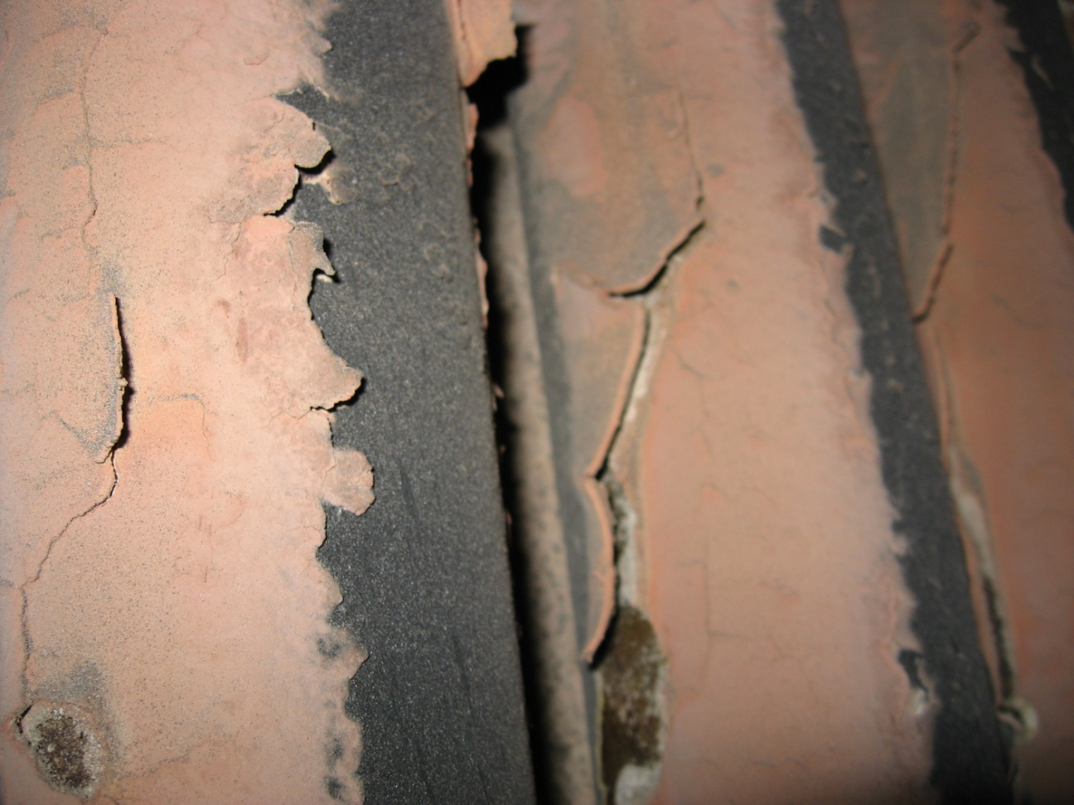
What is soot?
Soot is carbon deposits caused by incomplete combustion

Slide 38
The effect of soot:
Thickness ~Efficiency Loss
1/32” 2.5%
1/16” 5%
1/8” 9.5%

Slide 40
The Basic Log Book should record such readings as:
System Pressures
System Temperatures
Fuel Meter Readings
Fuel Inventory
Water Test Results
Chemical additions

Slide 43
The Basic Log Book should record such readings as:
System Pressures
System Temperatures
Fuel Meter Readings
Fuel Inventory
Water Test Results
Chemical additions

Slide 44
Fuel inventory:
Fuel inventory should be recorded on a regular basis (daily is recommended).
Fuel oil tank sounding charts should be readily available or calculations must be performed.
Fuel oil tanks should be sounded before and after deliveries and checked against delivery statement for accuracy.

Slide 45
Fuel meter readings:
Fuel oil is ideally metered to each separate burner.
Gas is typically metered at the plant inlet.
Points to remember:
1 gallon of #2 fuel oil contains ~ 138,000 BTU.
1 cubic foot of natural gas ~1,000 BTU.

Slide 46
The Basic Log Book should record such readings as:
System Pressures
System Temperatures
Fuel Meter Readings
Fuel Inventory
Water Test Results
Chemical additions

Slide 47
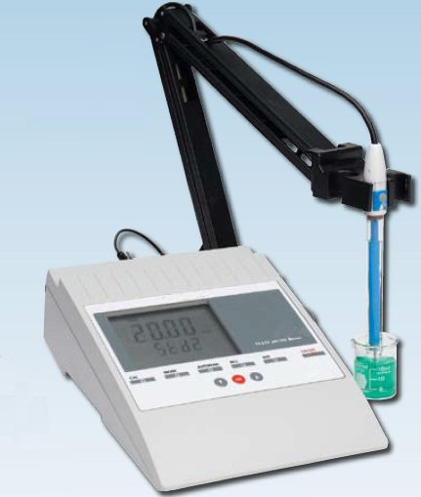
Boiler Water Test: Typical Data -
Boiler water conductivity.
Feedwater conductivity.
Condensate conductivity.
Boiler M-Alkalinity.
Boiler sulfite.
Boiler phosphate/polymer.
Boiler silica.
Feedwater hardness.
Condensate hardness.
Condensate pH.

Slide 48
Boiler Water Test: Typical Data -
Boiler water conductivity.
Feedwater conductivity.
Condensate conductivity.
Boiler M-Alkalinity.
Boiler sulfite.
Boiler phosphate/polymer.
Boiler silica.
Feedwater hardness.
Condensate hardness.
Condensate pH.

Slide 50
A sudden drop in boiler sulfite residual could indicate:
A malfunctioning feed pump.
A plugged injection point.
A malfunctioning deaerator.
Gross air in-leakage in the feedwater system.
Excessive make-up water.

Slide 51
Boiler Water Test: Typical Data -
Boiler water conductivity.
Feedwater conductivity.
Condensate conductivity.
Boiler M-Alkalinity.
Boiler sulfite.
Boiler phosphate/polymer.
Boiler silica.
Feedwater hardness.
Condensate hardness.
Condensate pH.

Slide 53
Increases in condensate return impurities indicate:
Possible contamination due to failed heat exchangers in the condensate system.
Improper plumbing of condensate vent lines.
Possible corrosion in the condensate system.

Slide 54
The Basic Log Book should record such readings as:
System Pressures
System Temperatures
Fuel Meter Readings
Fuel Inventory
Water Test Results
Chemical additions & boiler blowdown

Slide 56
Overall swings of boiler test results are most often the result of:
Inconsistent boiler blowdown.
Surface blowdown
Bottom blowdown
Continuous blowdown

Slide 57
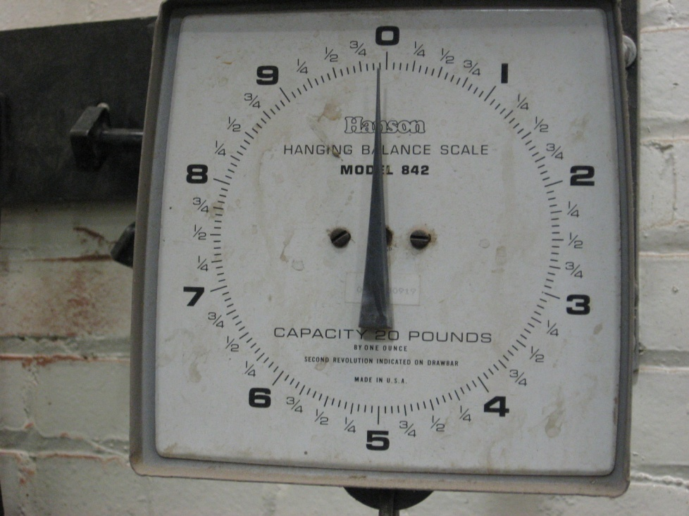
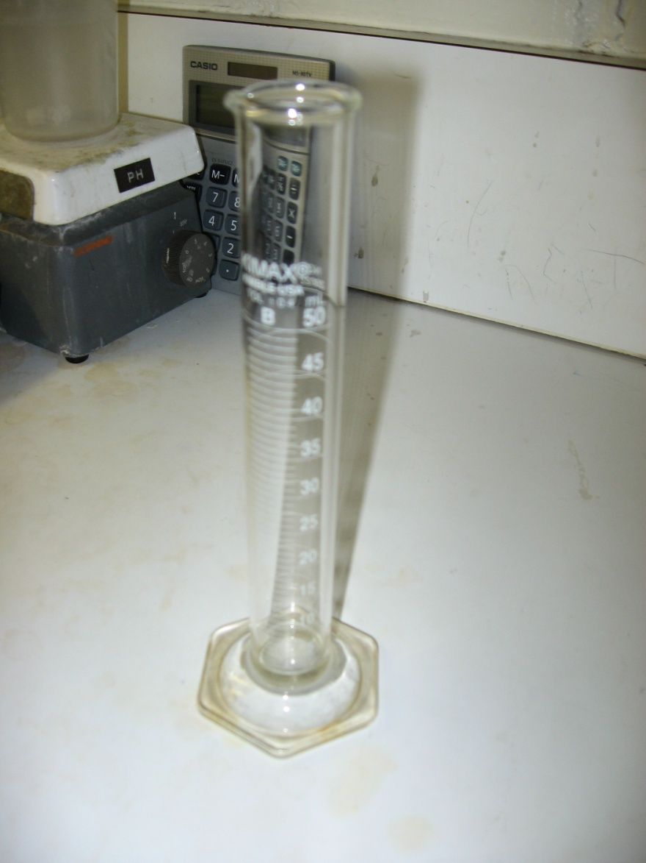
How to measure chemical additions:
Always measure chemical feed amounts to insure consistent results.

Slide 58
How can we learn what the log sheet is telling us?
Operator Training!

Slide 59
QUESTIONS?
Presented By The American Society of Power Engineers, Inc.™
A Non-Profit Cooperation
For More Information or a copy of his presentation contact:
www.asope.org
E-Mail office@asope.org
866-926-1821

